Slide 1
Project Based Learning: An Effective Approach for Teaching Today
John Larmer
June 15, 2021

Slide 2
My Background:
2001-2021: Buck Institute for Education, dba PBLWorks
Now an independent consultant
High school teacher (social studies & English)
Live in Mill Valley, CA (just north of San Francisco)

Slide 3
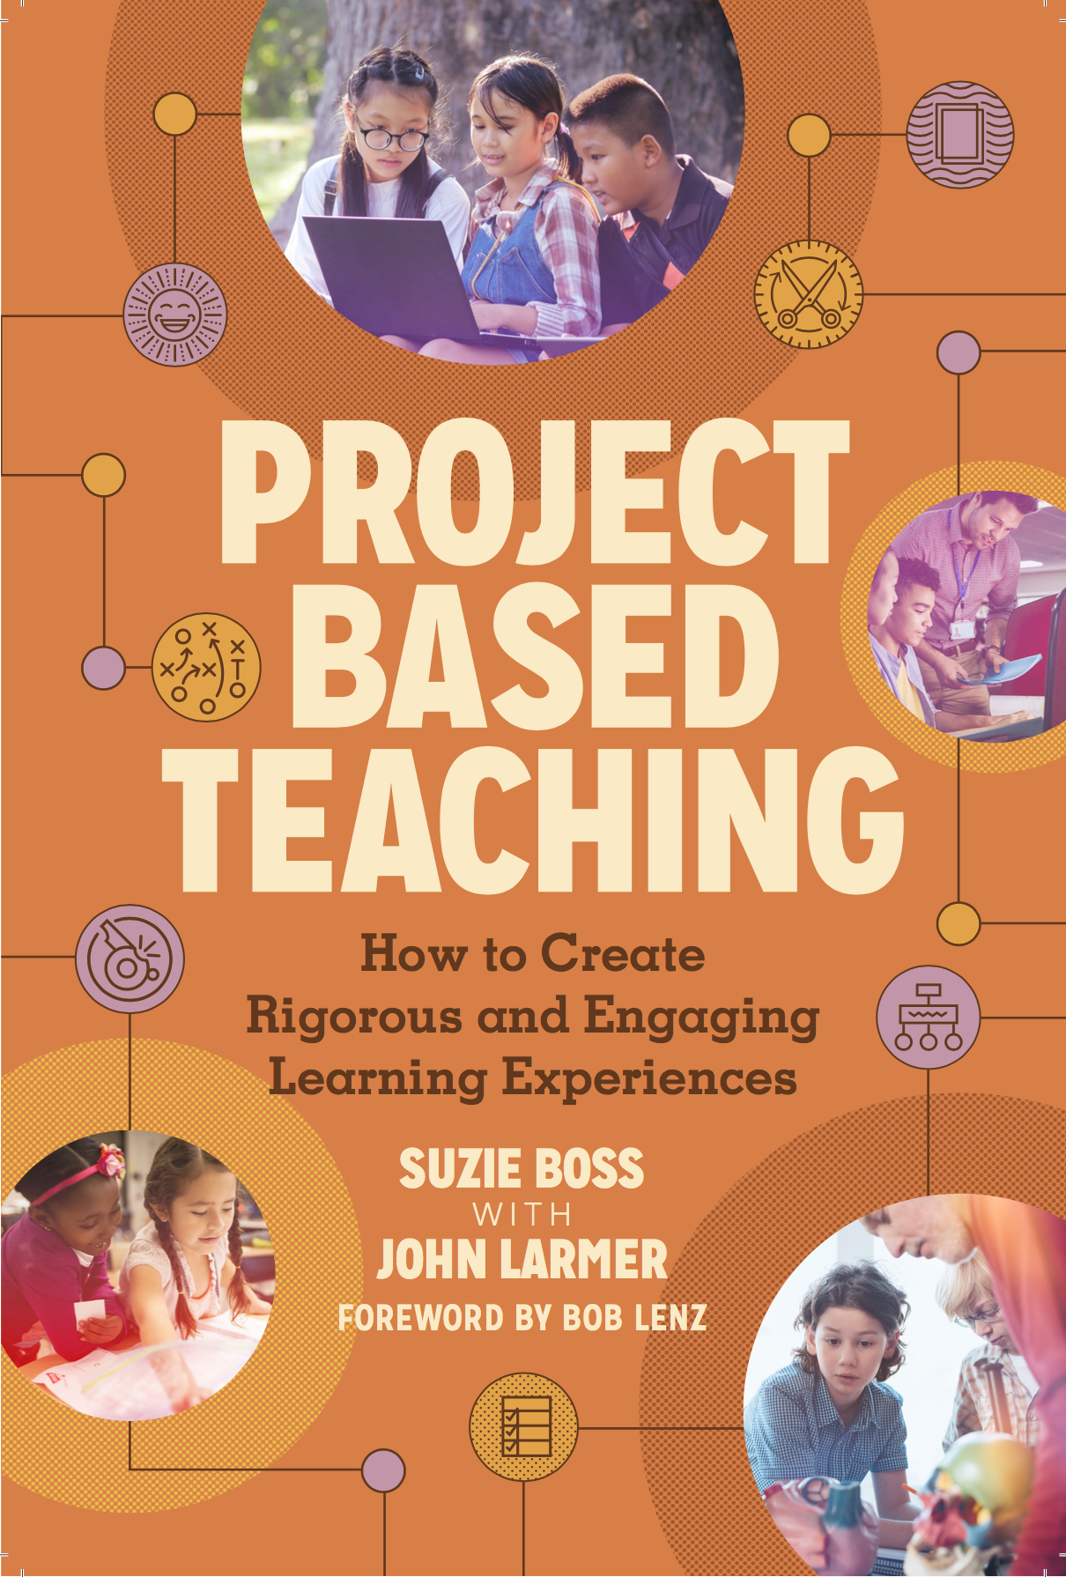
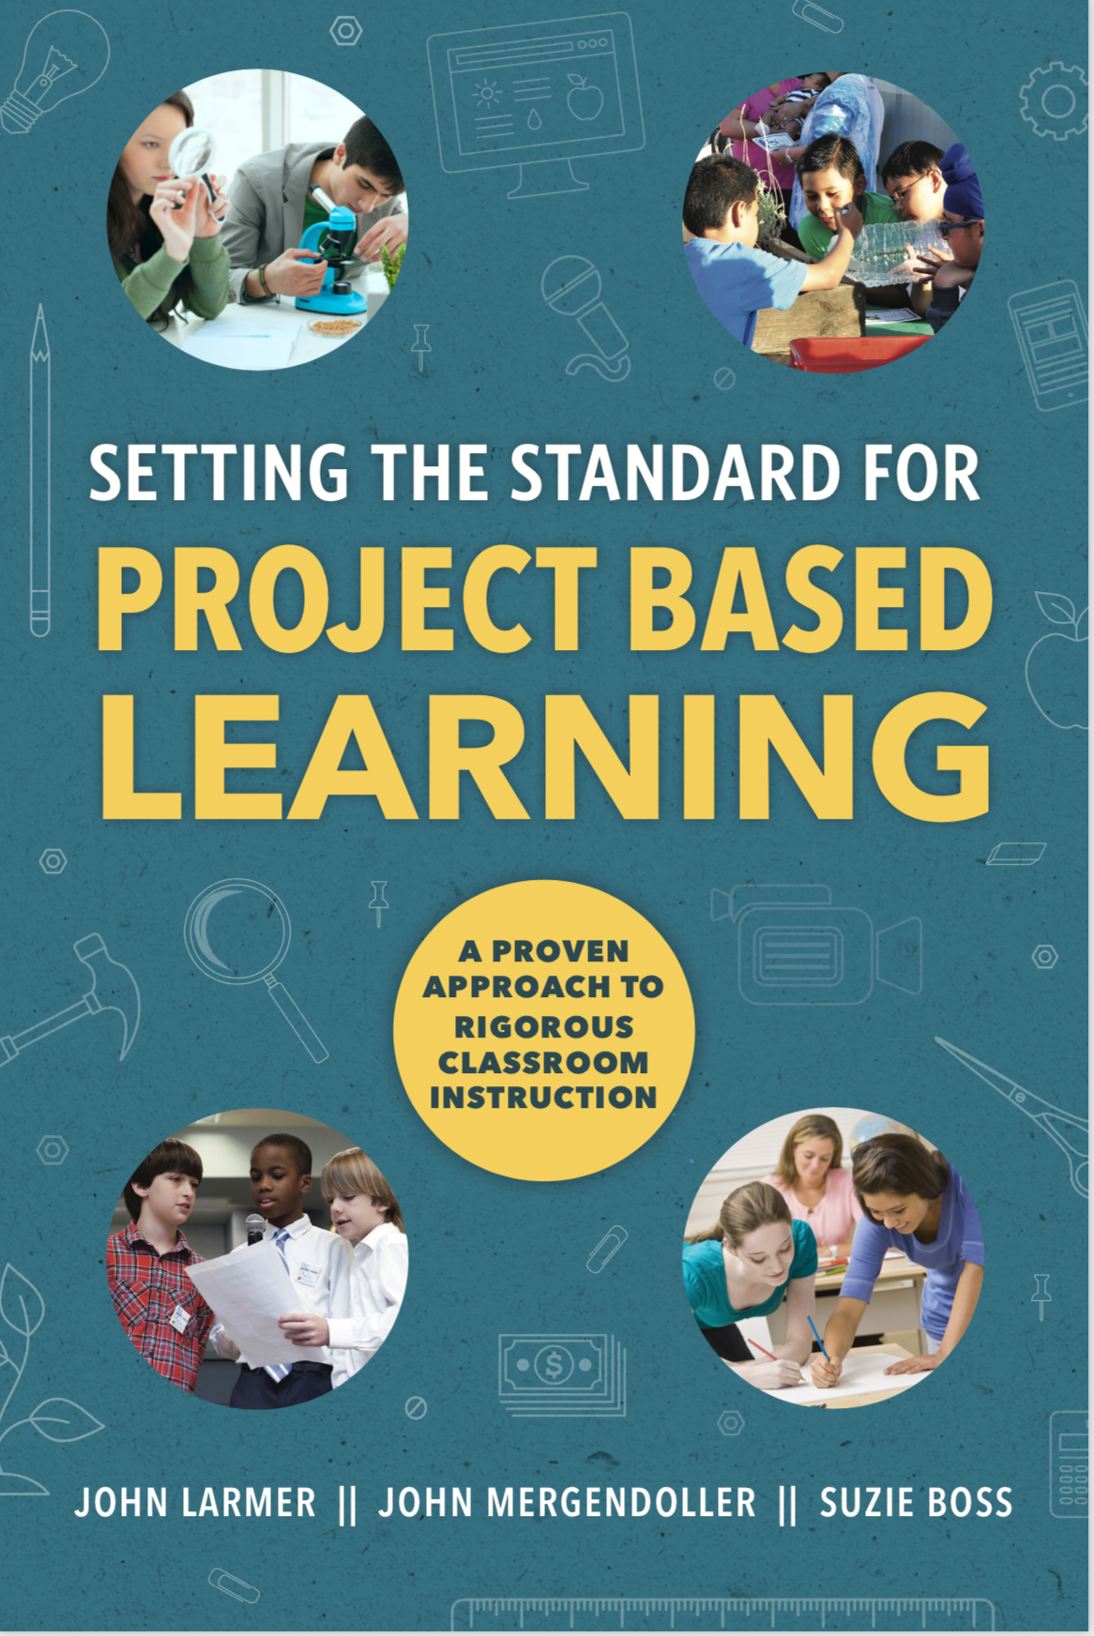
ASCD/Buck Institute for Education, 2018 & 2015

Slide 4
Agenda
Why PBL is a good idea
What PBL is and is not: Misconceptions
Types of Projects: Dessert to Main Course
Gold Standard PBL: 7 Project Design Elements
Q & A

Slide 5
“Project based learning… did not teach me to sit quietly. Rather it taught me to be adaptable and embrace ambiguity, to seek out the value in others and lead inclusively, and to be confident in forging my own life and career.”
- Katie Wynne, high school graduate

Slide 6
Why Education May (Should) Now Shift in a PBL Direction: Lessons from the Pandemic
It’s time to “clean up” the curriculum; don’t try to “cover” as much fact-based knowledge; depth over breadth
Move from passive/compliant to active/engaged learning
Move from fixed to flexible time for learning
It’s time for more authentic learning; students are eager to tackle real-world issues

Slide 7
More engaging way to
learn
Why PBL??

Slide 8
More engaging way to
learn
Improves learning
Why PBL??

Slide 9
More engaging way to
learn
Improves learning
Builds success skills for
college, career, & life
Why PBL??

Slide 10
More engaging way to
learn
Improves learning
Builds success skills for
college, career, & life
Rewarding for teachers!
Why PBL??

Slide 11
Project Based Learning is a teaching method in which students gain knowledge and skills by working for an extended period of time to investigate and respond to an authentic, engaging, and complex question, problem, or challenge.

Slide 12
Project Based Learning… & Its Cousins
Problem Based Learning
Place Based Learning
Inquiry Based Learning
Design Thinking
(see my blog post, ”Project Based Learning vs. Problem Based Learning vs. XBL”
at PBLWorks.org or Edutopia.org)

Slide 13
Common Misconception
PBL is not effective for teaching factual knowledge; can’t cover as much content; the focus is on “soft skills” not content

Slide 14
Common Misconception
Projects are too hard for teachers to manage when students are working independently on different projects

Slide 15
Common Misconception
Some students aren’t able to work well
in a PBL classroom

Slide 16
Common Misconception
The teacher doesn’t “teach” in PBL; only acts as facilitator

Slide 17
Common Misconception
Research doesn’t show PBL works

Slide 18
Three New Studies of PBL
Large number of teachers and students from “regular”
public schools, in randomized control groups
Students from diverse backgrounds (race, English fluency, family income level)
Achievement measured by traditional tests
PBL curriculum units designed by university researchers, not teachers

Slide 19
Three New Studies of PBL
1. Second Grade Social Studies and Literacy
PBL can raise student achievement in high-poverty communities.
Gains made by the PBL group were 63% higher in social studies and 23% higher in informational reading than the control group.
“Putting PjBL to the Test: The Impact of Project-Based Learning on Second Graders’ Social Studies and Literacy Learning and Motivation in Low-SES School Settings”
(Duke, et al., 2020)
www.pblworks.org/research/publications

Slide 20
Three New Studies of PBL
2. Third Grade Science and Social-Emotional Learning (SEL)
3rd graders in PBL classrooms performed 8 percentage points better on a science assessment than students in traditional classrooms.
“Significant and positive effects” found on social and emotional learning related to science learning. “Specifically, students more frequently reported the value of reflection and collaboration.”
“Assessing the Effect of ML-PBL on Science Learning” (Krajcik et al., 2021).
https://mlpbl.open3d.science/techreport

Slide 21
Three New Studies of PBL
3. High School Advanced Placement Environmental Science
and U.S. Government & Politics
Students taught with a PBL approach passed their AP tests at an 8% higher rate than students in traditionally taught classrooms. In the second year of the study the rate increased to 10%.
Students from low-income households gained as much as higher-income students.
“Knowledge in Action Efficacy Study Over Two Years” (Saavedra et al., 2021).
www.edutopia.org/article/new-research-makes-powerful-case-pbl

Slide 22
Agenda
Why PBL is a good idea
What PBL is and is not: Misconceptions
Types of Projects: Dessert to Main Course
Gold Standard PBL: 7 Project Design Elements
Q & A

Slide 23
The belief that all genuine education comes about through experience does not mean that all experiences are genuinely or equally educative.
- John Dewey

Slide 24
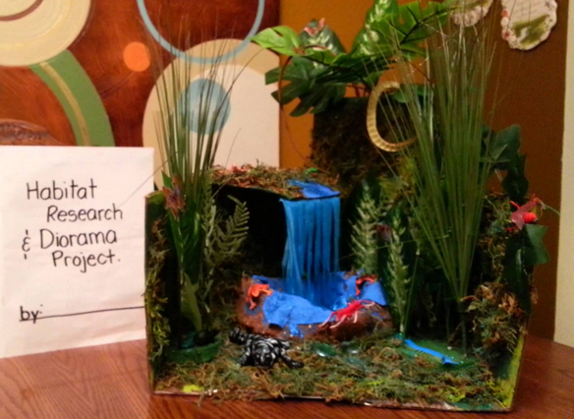
“Dessert” Project

Slide 26
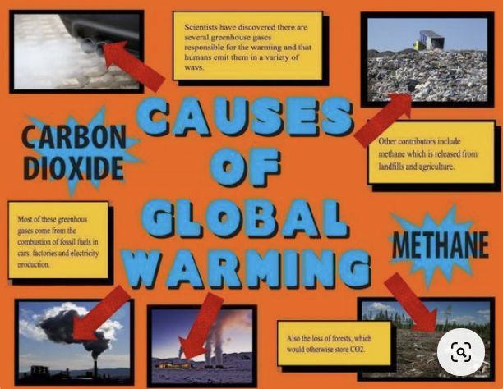

Slide 27
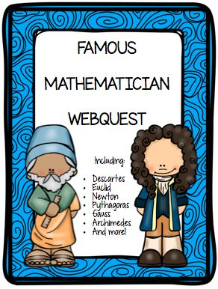

Slide 28
“Main Course” PBL Project:
Students Skype with staff at Detroit Zoo, are told habitats for new animals are needed
Students design habitats & write proposals
Students present models of habitats to zoo’s education director

Slide 29
Different Ways to Think About “Doing Projects”
Dessert/side dish:
“Project” is typically a research/presentation or “make something” type of task; usually done individually; students often choose the topic but follow directions
Applied learning experience:
Project is done after traditional instruction; “capstone” or “applied learning” experience
Main Course PBL:
Knowledge & skills are learned through doing the project; the project is the framework for instruction

Slide 31
KEY KNOWLEDGE, UNDERSTANDING, & SUCCESS SKILLS

Slide 32
Success Skills:
Critical Thinking / Problem Solving
Collaboration
Communication
Creativity/Innovation
Project Management

Slide 33
Sustained Inquiry:
Not just “researching information” but also determining stakeholders’ needs & wants, best way to use or do something
In-depth, over time
Driven by students’ questions
Iterative process

Slide 34
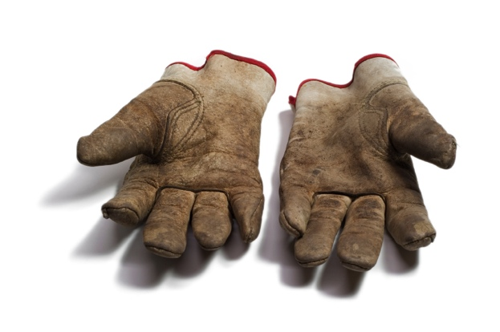
Authenticity:
Real-world context
(from simulated to actual)
Real-world tools & tasks
Makes a real impact
Relevant to students’ lives,
cultures, interests

Slide 35
Student Voice & Choice:
Problems, topics & driving
question
Process
Products
Opportunities to express
themselves

Slide 36
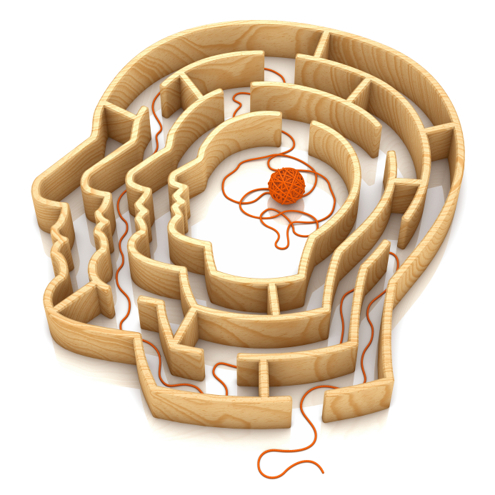
Reflection:
What students are learning
How students are learning
Process & products
Project design & execution
During & after project

Slide 37
Critique & Revision:
Regular, structured opportunities
Students know how to give & use
feedback
Self, peer, teacher, stakeholders,
outside experts

Slide 38
Public Product:
Shared with people beyond the
classroom
Increases motivation and
accountability
Includes explanation of
process, not just product
Makes student work “discussable”
(informs instruction, creates shared
standards)

Slide 39
Any Questions?

